Slide 1
PowerLine E Air Series
Product Presentation

Slide 2
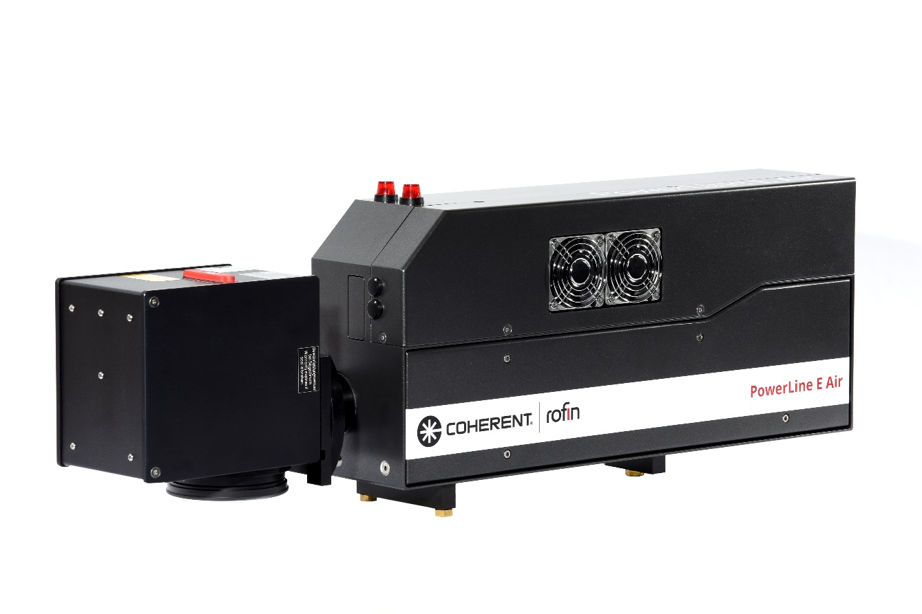
PowerLine E Air 10 / 25
Features at a glance
Completely air-cooled
Different power ranges
Doubleheader configurations available
Low operating costs
Almost maintenance free
Integration-friendly

Slide 3
PowerLine E Air Series
Customer Benefits
High quality markings with alpha-numerics, graphics, grayscale pictures, barcodes and matrix codes on various materials
Available with water-air cooling and wavelengths of 1064 / 532 / 355 nm for certain material requirements
Double head configurations with beam splitter and beam switch offer benefits when large marking fields or minimum process times are required
PC and supply components housed in standard 19’’ modules
Easy to integrate into COHERENT | ROFIN or customer-specific laser workstations

Slide 4
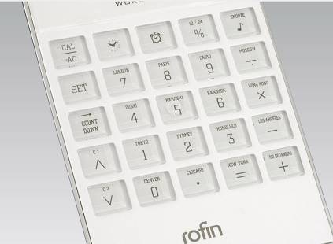
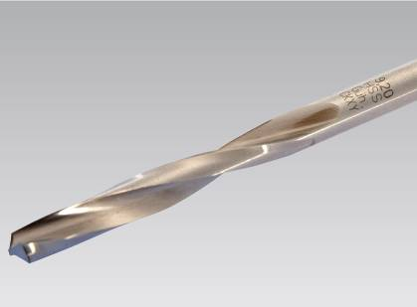
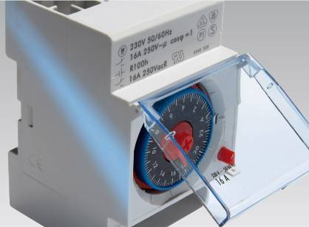
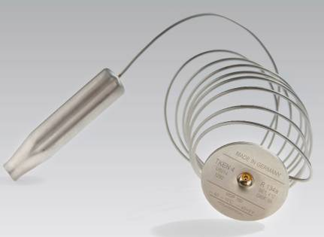
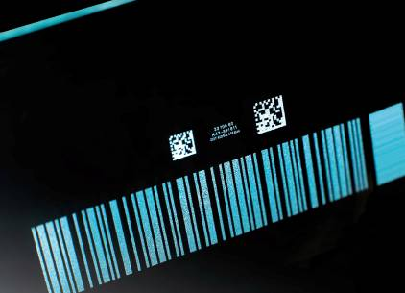
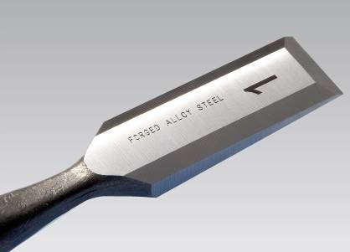
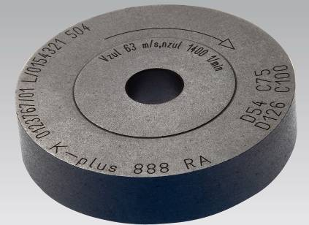
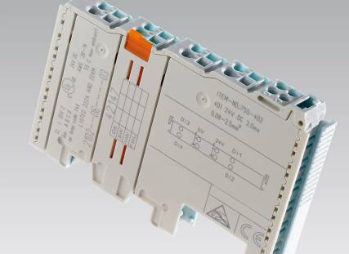
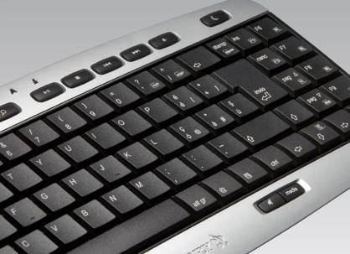
Application Examples
Personalization
Annealing
Identification
Traceability
Machine readable codes
Deep engraving
Circular marking
Color change
Just-in-time marking

Slide 5
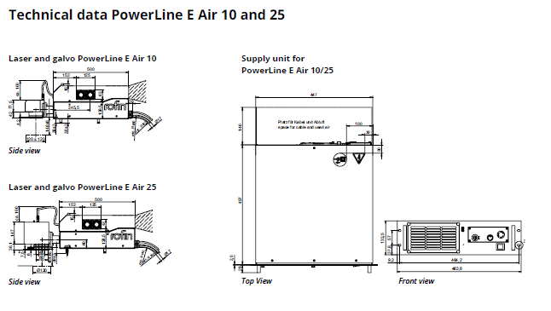
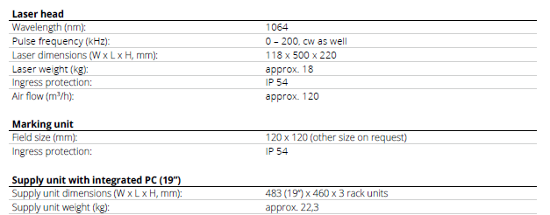
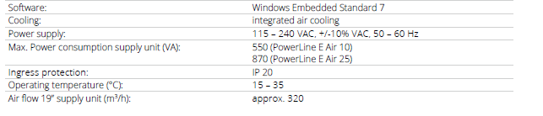
PowerLine E Air 10
Technical Data

Slide 6
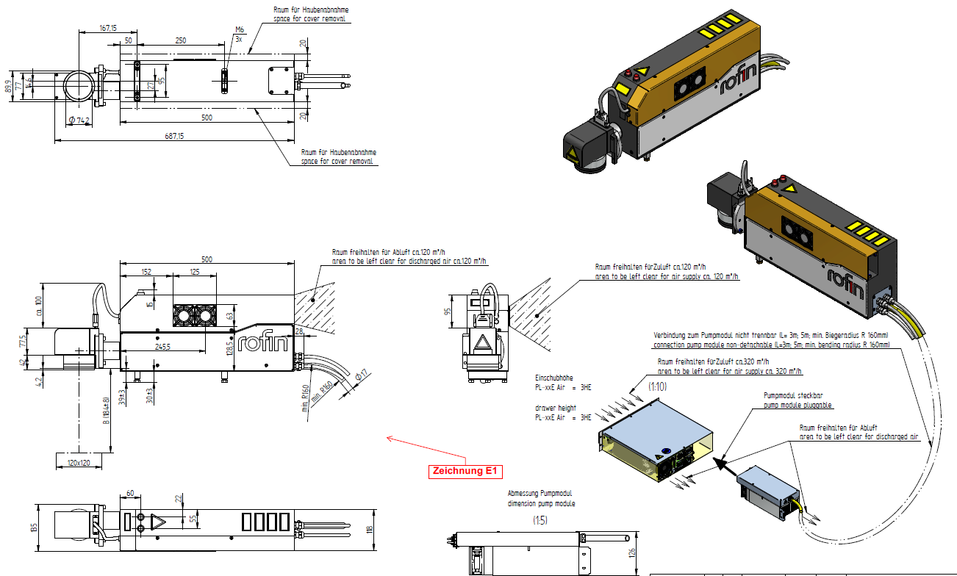
PowerLine E Air 10

Slide 7
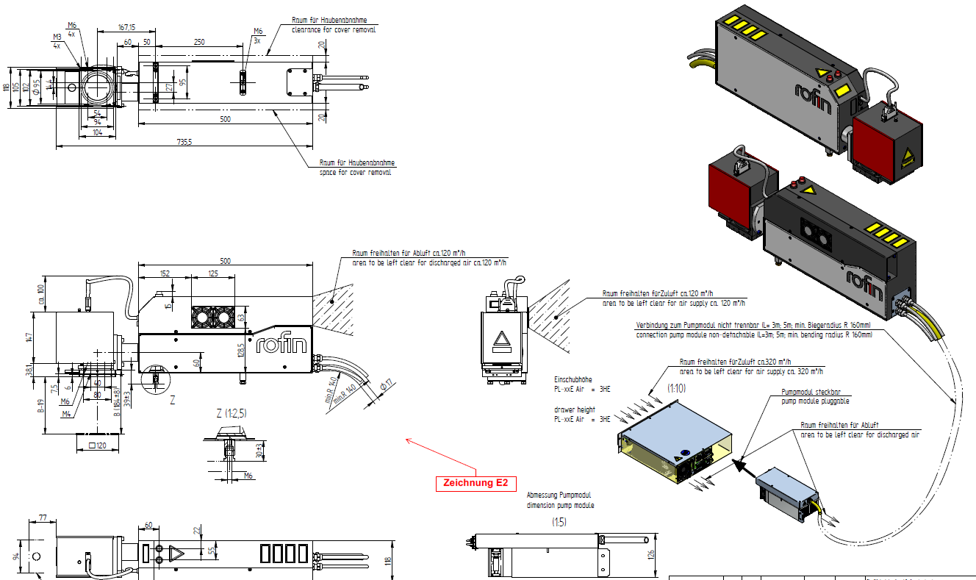
PowerLine E Air 25

